Slide 1
Crisis Analysis from Social Media
Using Hadoop MapReduce
Storm Riders
Gaurav Shad
Nitesh Gupta
Abhishek Vellanki

Slide 2
Group project Description
List of Tasks
Task 1 – Deploying Hadoop on Cloud
Task 2 – Extracting Twitter data using FLUME
Task 3 – Designing Mapper and Reducer
Task 4 – Data Visualization
Task 5 – Developing user interface
Task 6 – Testing and Refining

Slide 3
Project Description (cont.)
Tasks allocation
 | Gaurav Shad | Nitesh Gupta | Abhishek Vellanki
Deploying Hadoop on Cloud | 34% | 33% | 33%
Extraction of Twitter Data using FLUME | 33% | 33% | 34%
Designing Mapper and Reducer | 33% | 34% | 33%
Data Visualization | 33% | 33% | 34%
Developing User Interface | 33% | 34% | 33%
Testing and Refining | 34% | 33% | 33%

Slide 4
Technical Details
Software used
  Apache Hadoop
  Open Stack
  Apache FLUME
  Twitter API
  Data Visualization – Big Insights or Spark

Slide 5
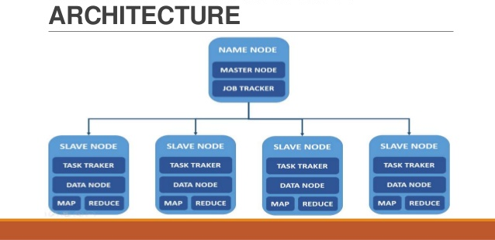
Technical Details
Project setup

Slide 6
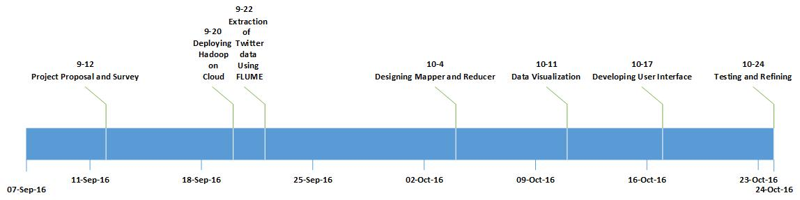
Technical Details
Roadmaps of your project

Slide 7
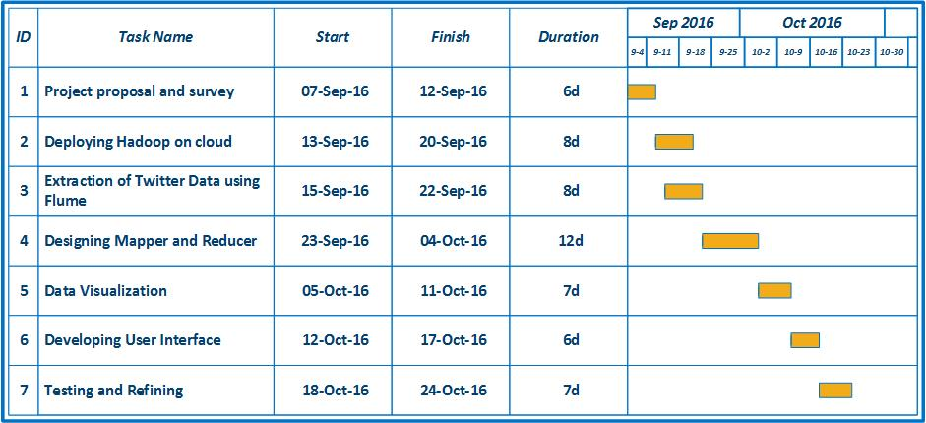
Technical Details
Roadmaps of your project

Slide 8
Technical Details
Social Media contains wide variety of data that can be analyzed to get meaning information. However the amount the data that needs to be analyzed is so big that its processing is inefficient on a single machine.
– This problem can be addressed by merging cloud computing and Hadoop to do distributed computing of data.

Slide 9
Technical Details (cont.)
We will setup Hadoop and configure its files and make a multi node cluster on a private cloud which is the main requirement to process the data.
The project concentrates on the data set retrieved from Twitter based on time filtering (like last 5 years) and process this data to represent end user how prone a region is to a crisis.
We will design a Mapper and Reducer which will filter tweets based on certain conditions similar to the ones used by NEIC (National Earthquake Information centre)

Slide 10
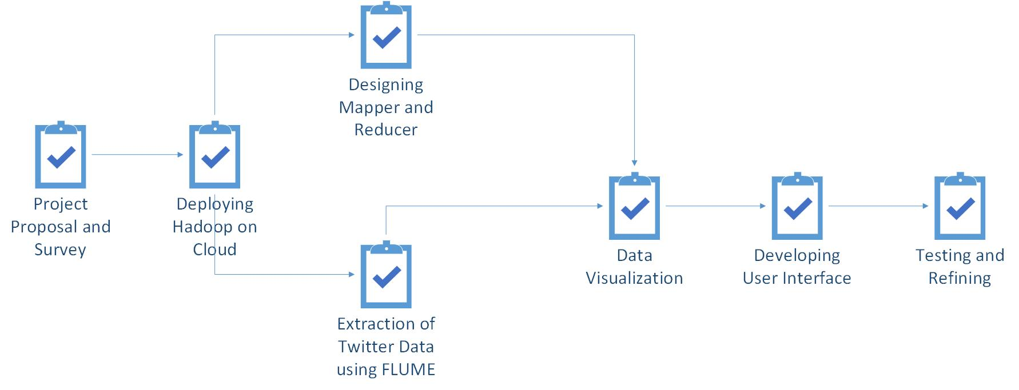
Technical Details (cont.)
Task Dependencies

Slide 11
Risks and Benefits
Novel aspects of this project:
  This project gives the user information not only about natural disasters but any large scale incident that grabs people’s attention
  The user can also enter the name of a crisis to figure out which regions it has hit
Risks/challenges:
  Issue can come up with configuration of XML files for Hadoop installation
  Lack of large data sets on twitter due to rate limit on twitter API
  Distinguishing useful tweets from others
Potential applications & benefits:
  The output from this project can be used to figure out which regions are prone to crisis

Slide 12
Tasks Accomplished by Now
Project proposal
Software Requirement Analysis
Information gathering for Hadoop
Established the parameters to filter the tweets

Slide 13
Project Progress
Tasks Completed
Task 1: Deploying Hadoop on Cloud
In this task we setup Hadoop on private cloud in Thoth Lab and got it working. For this we understood how Hadoop works and then configured the XML files accordingly and setup the HDFS.

Slide 14
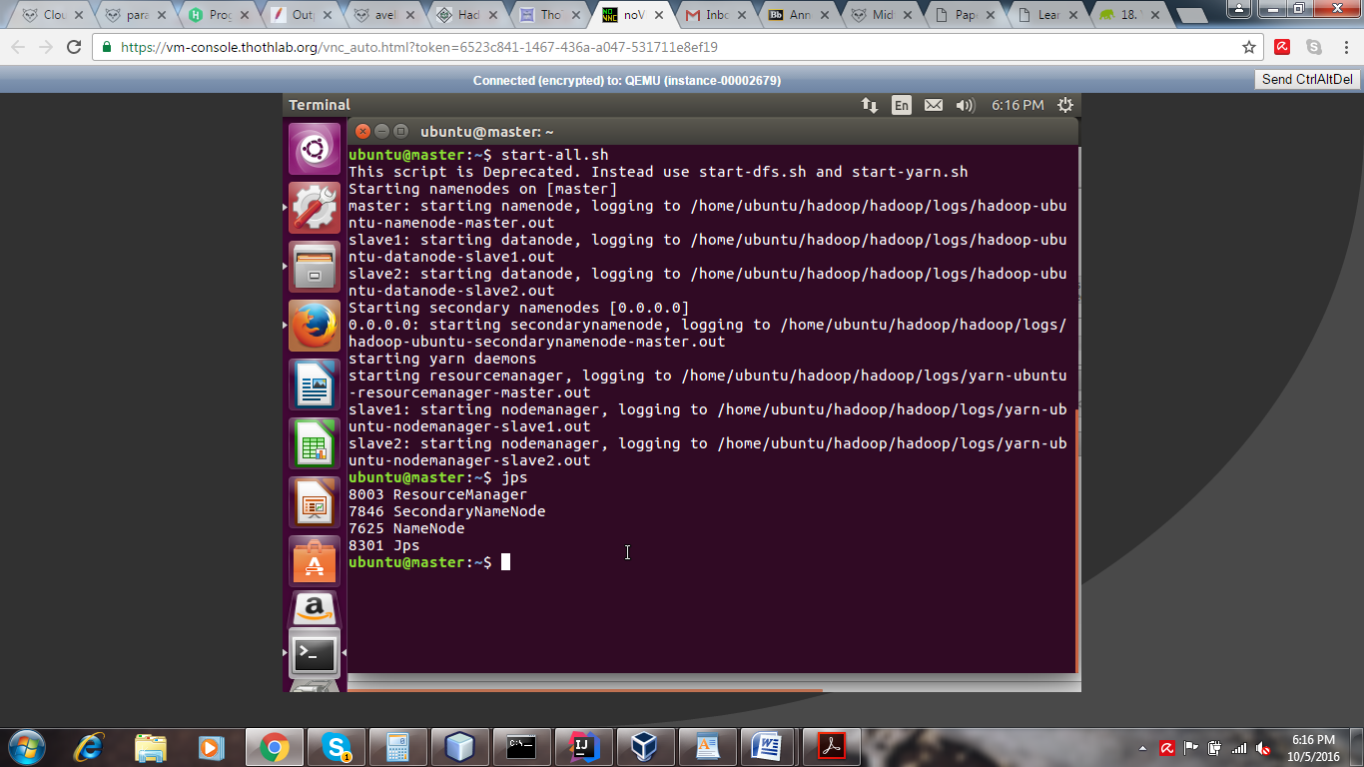
Project Progress
Task 1: Deploying Hadoop on Cloud

Slide 15
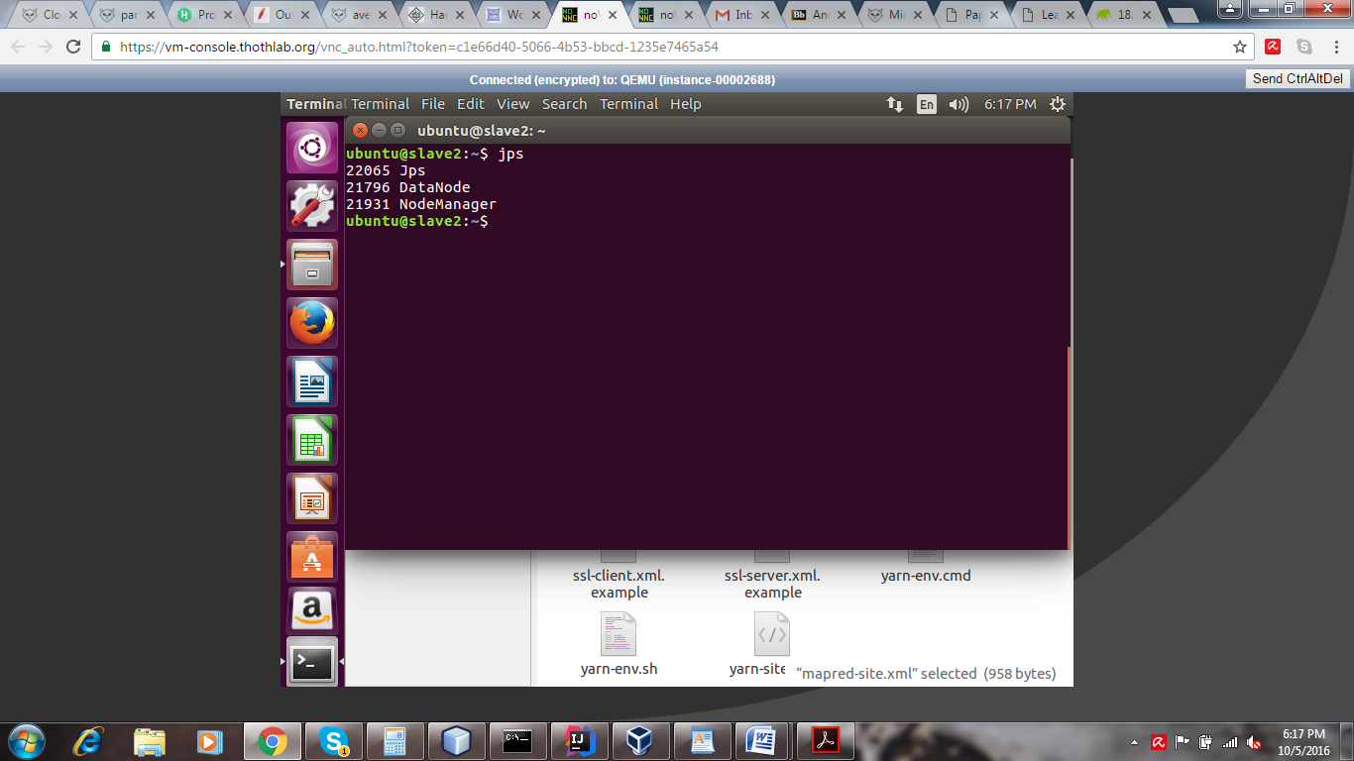
Project Progress
Task 1: Deploying Hadoop on Cloud

Slide 16
Project Progress
Tasks Completed
Task2: Extraction of Twitter data using FLUME
In this task we collected Twitter data using Twitter APIs.
Twitter has 2 types of API to collect their data.
Streaming API
REST APIs

Slide 17
Project Progress
Streaming API
The Streaming API gives us tweets in real-time. As the tweets are posted in twitter they get pushed into the HDFS. Apache FLUME has been used to integrate with this streaming API
To get this specific data we require to modify the TwitterSource.java, compile it and generate TwitterSource.class and TwitterClass$1.class. This file is uploaded in gitlab along with the TwitterSource.java file.

Slide 18
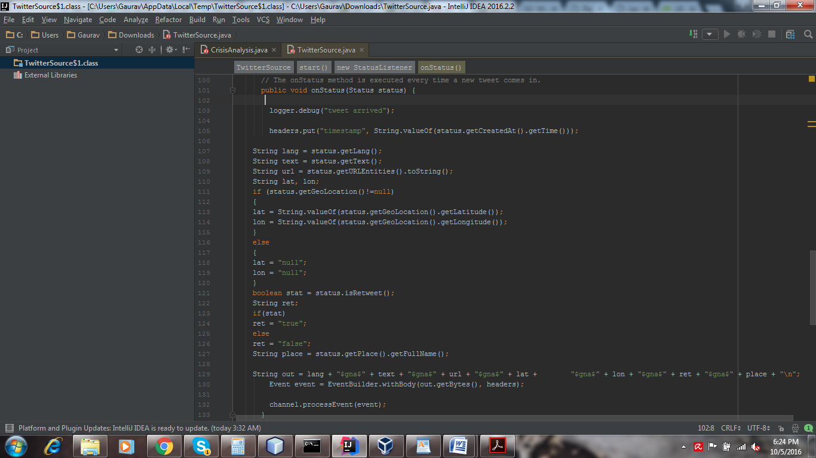
Project Progress
Streaming API (TwitterSource.java)

Slide 19
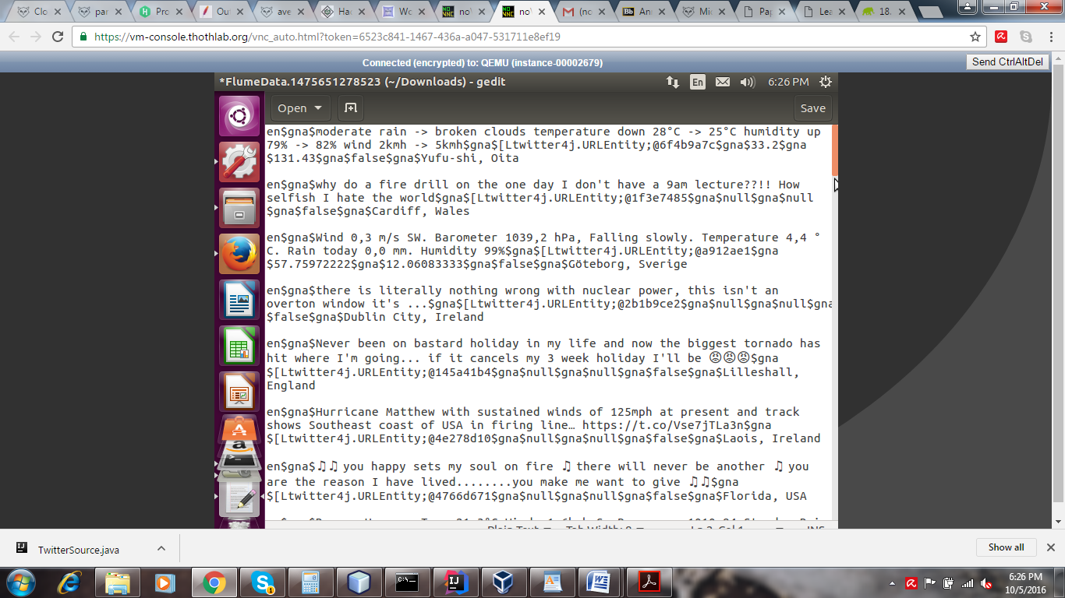
Project Progress
FLUME Output

Slide 20
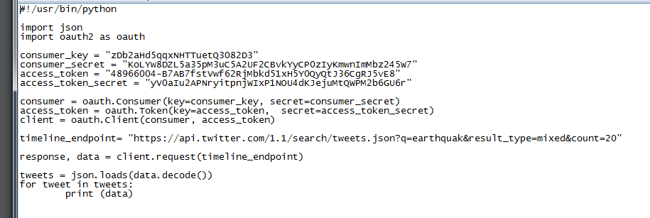
Project Progress
REST API
Since our application also requires historical data, we used a REST API by twitter to get some old twitter data as proof of concept. We used a Python Script to connect to the REST API which will search data from last 7 days.

Slide 21
Project Progress
Tasks Completed
Task 3: Designing Mapper and Reducer
We designed a MapReduce which is the important part of Hadoop framework to process the tweets.
The tweets will be filtered out in the Mapper class.
The Mapper class will give output as key value pairs which then be combined and used by Reducer class to generate final output.

Slide 22
Challenges and Roadblocks
Historical Data
Twitter does not provide complete historical data with its APIs. At most one-week old data can be collected using the REST API.
As historical data is critical for our project we have to look for a twitter data dump posted by anyone online.
We found such data at archive.org

Slide 23
Challenges and Roadblocks
Configuring flume to give us the specific data:
Accessing the json particular fields was a bottle neck since we didn’t need to analyze whole data from json.
We had to overwrite the TwitterSource.java
To compile the TwitterSource.java it required to import packages like org. apache. flume, twitter4j, org. json. simple and slf4j after all the packages were locally added.
Then we built the java file for class file generation.

Slide 24
Conclusion
The project results in Data Visualization from the output of MapReduce algorithm.
The project returns a graphical representation of the crisis that has happened in the region queried by the user.
The tweets are streamed using Hadoop, FLUME and Twitter data dump.
Mapper and Reducer will be used to filter out the tweets and process the required data.
A User Interface will help the user interact with the application to get the required information.

Slide 25
Thank You !

